Slide 1

Genome mapping
Axel LEVY
Corentin SOUBEIRAN
March 2022
INF589 - Computational analysis of high-throughput sequencing data

Slide 2




Summary

Slide 3

Why mapping genome ?

Slide 4
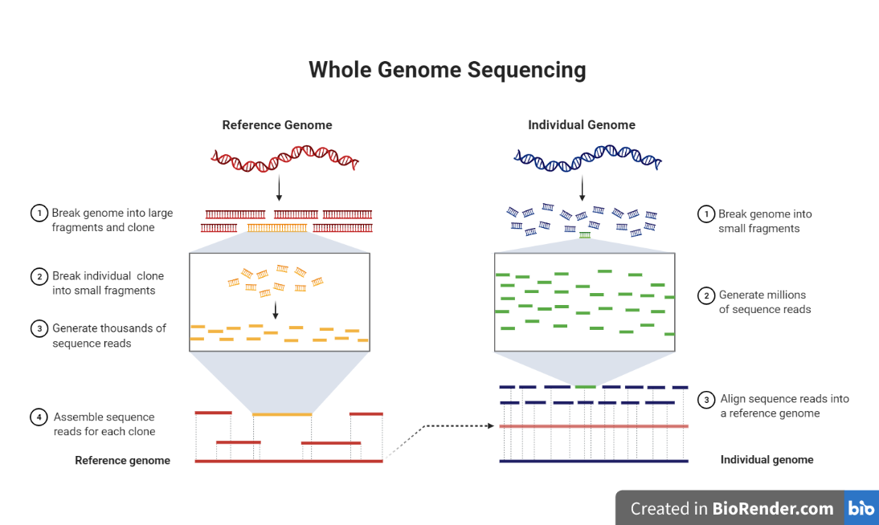
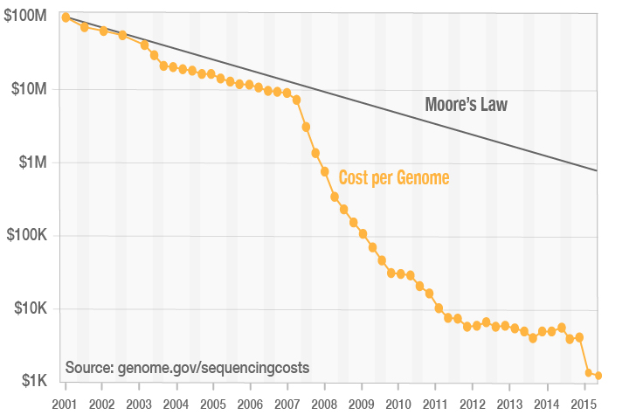
Why mapping genome ?
Main idea: capitalize on knowledges
Reduce drastically the computations and the cost

Slide 5

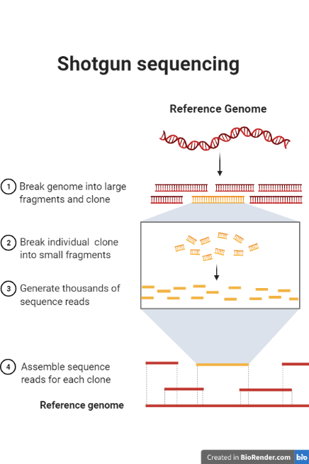
Why mapping genome ? - Example
Without mapping:
Genome length: 1000b
Fold: 5
Read length 100 (std=50)
Computation time: 84ms
With mapping:
Genome length: 1000b
Fold: 1
Read length 100 (std=50)
Computation time: 8ms

Slide 6

How to map genome ?

Slide 7
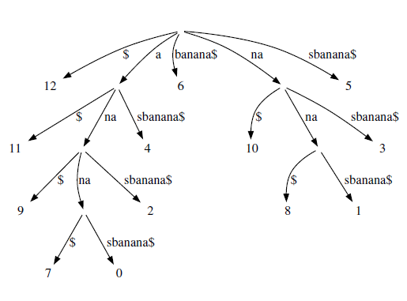
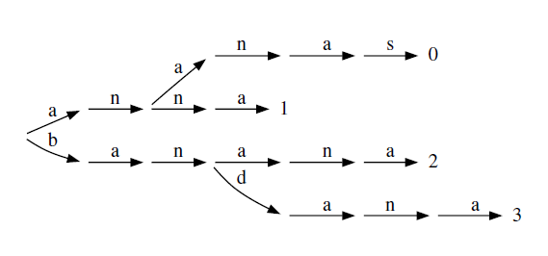
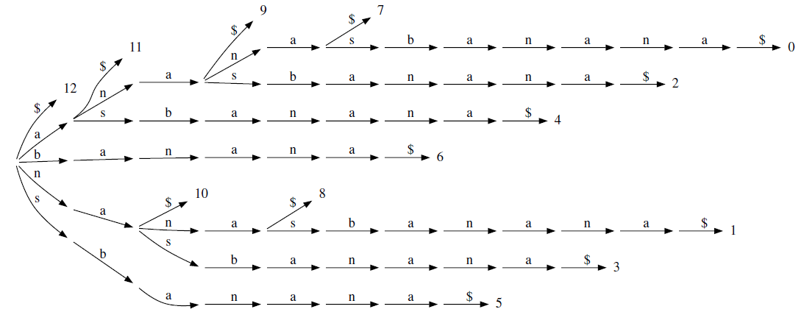


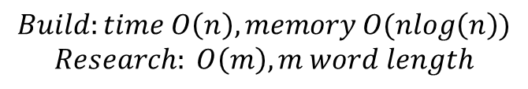
Different methods
Prefix Tries
Suffix Tries
Compact suffix tries = Suffix Trees
Change point of view
$$Build:time O\left(n\right), memory O(nlog\left(n\right))$$
$$Research: O\left(m\right), m word length$$
(of words) $research O(m∗n)$
(of sequence)$research O(m)$
Notes:
Axel

Slide 8
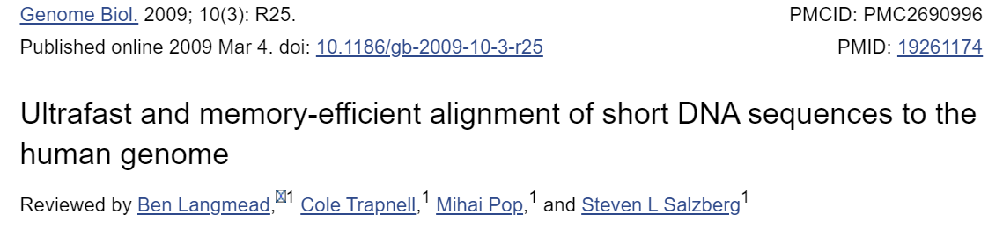
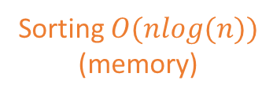
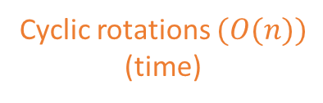
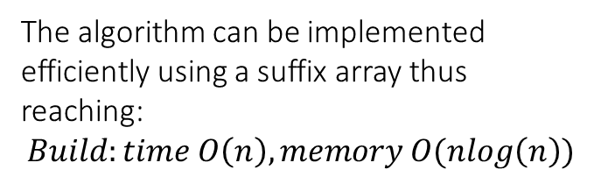
Burrows-Wheeler transform
= a pre-processing used in data compression
The algorithm can be implemented efficiently using a suffix array thus reaching:
$$Build:time O\left(n\right), memory O(nlog\left(n\right))$$
$bananas
s$banana
as$banan
nas$bana
anas$ban
nanas$ba
ananas$b
bananas$
$bananas
ananas$b
anas$ban
as$banan
bananas$
nanas$ba
nas$bana
s$banana
b
a
n
a
n
a
s
$
BWT
sbnn$aaa
Cyclic rotations $(O(n))$
(time)
Sorting $O(nlog(n))$ (memory)

Slide 9


Burrows-Wheeler transform
= a pre-processing used in data compression
First
Last
$bananas
s$banana
as$banan
nas$bana
anas$ban
nanas$ba
ananas$b
bananas$
$bananas
ananas$b
anas$ban
as$banan
bananas$
nanas$ba
nas$bana
s$banana
b
a
n
a
n
a
s
$
Trace back a sequence from last letter to first
$$Research: O\left(m\right), m word length$$
Cyclic rotations $(O(n))$
Sorting $O(nlog(n))$

Slide 10
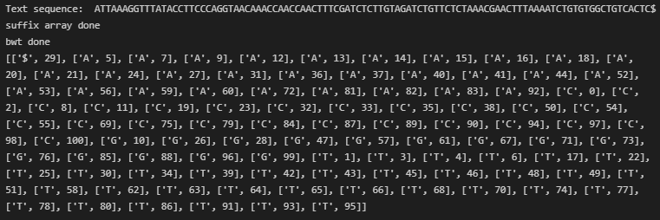
Burrows-Wheeler transform
= a pre-processing used in data compression
First
Last
$bananas
s$banana
as$banan
nas$bana
anas$ban
nanas$ba
ananas$b
bananas$
$bananas
ananas$b
anas$ban
as$banan
bananas$
nanas$ba
nas$bana
s$banana
b
a
n
a
n
a
s
$
Cyclic rotations $(O(n))$
Sorting $O(nlog(n))$

Slide 11
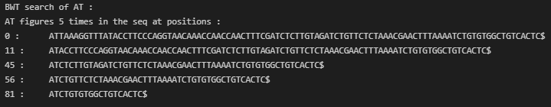
Burrows-Wheeler transform
= a pre-processing used in data compression
First
Last
$bananas
s$banana
as$banan
nas$bana
anas$ban
nanas$ba
ananas$b
bananas$
$bananas
ananas$b
anas$ban
as$banan
bananas$
nanas$ba
nas$bana
s$banana
b
a
n
a
n
a
s
$
Cyclic rotations $(O(n))$
Sorting $O(nlog(n))$

Slide 12

Results

Slide 13
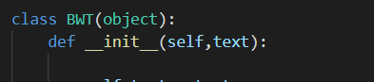
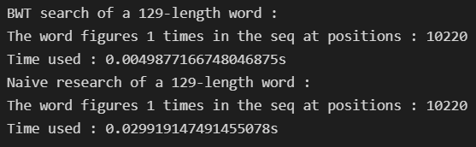
BWT search vs Naive search
Notes:
Axel

Slide 14
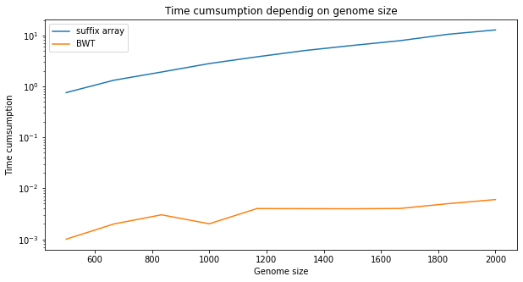
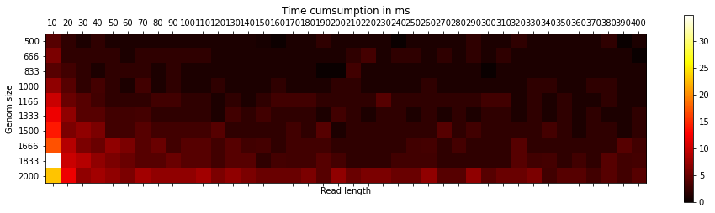
Simple implementation – construction/mapping
Sublinear complexity in log scale (ie. nlogn) for construction (limited by memory access)
Short read length increase complexity because more probability to have different choices and more comparisons
Notes:
Corentin

Slide 15
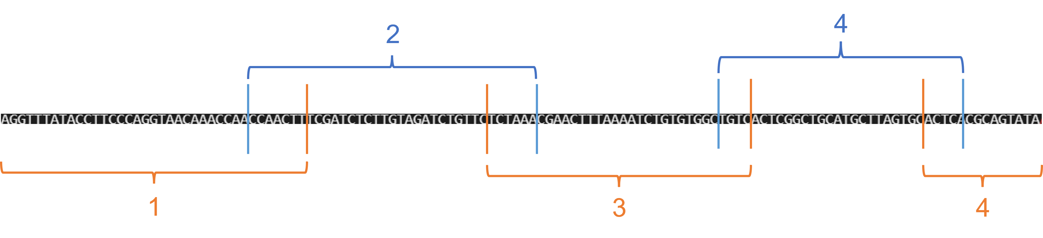
Issue : memory consumption
Suffix array : memory -> impossible to compute for n>2000…
2 Parameters : Length and Overlap
Notes:
Axel

Slide 16
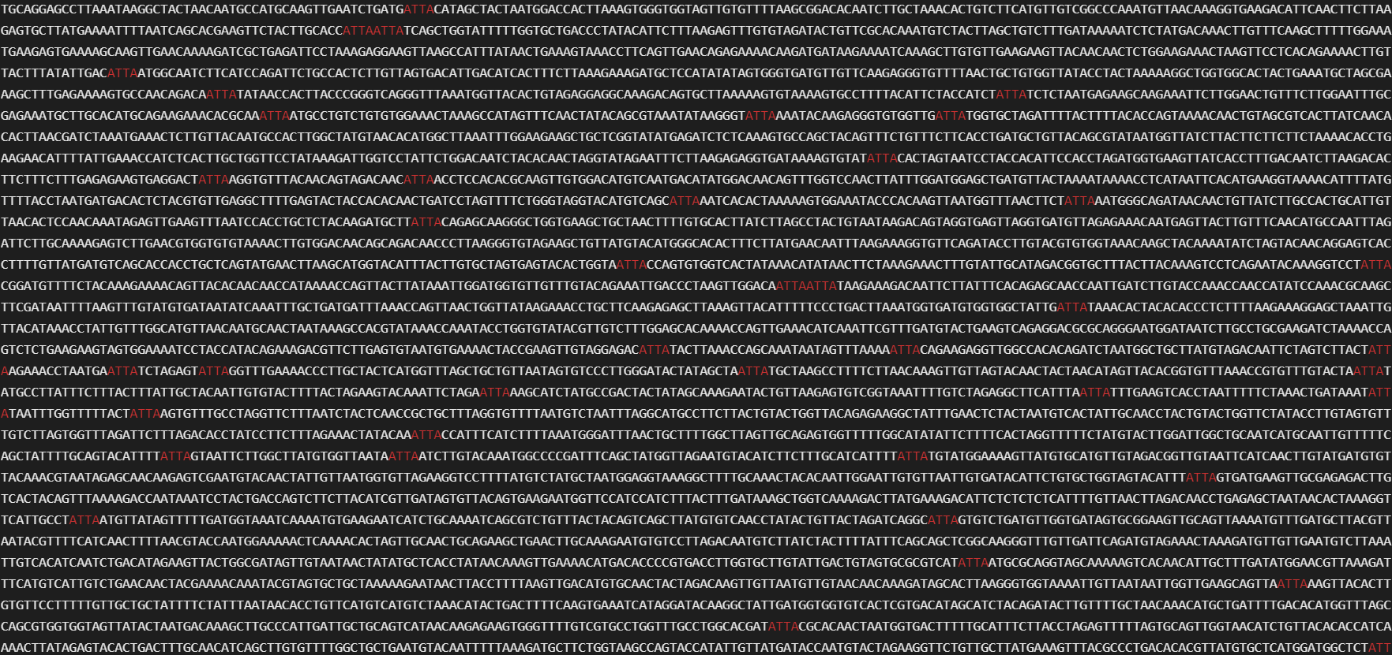
Search « ATTA » in a 10000 length sequence
Notes:
Axel

Slide 17

Conclusion and perspectives

Slide 18

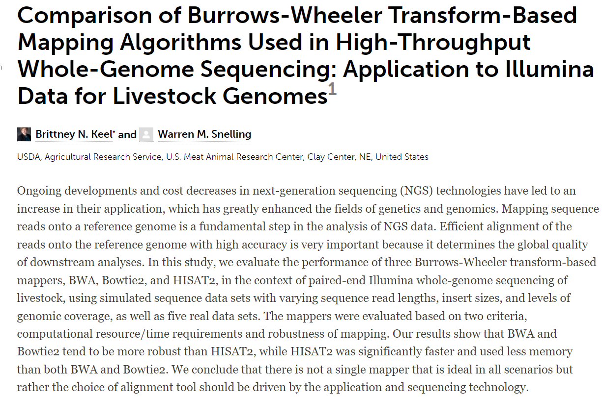
Conclusion and perspectives
Add errors or mutations: quantify sequence and read matching

